Slide 1
ECEN 403:
Active Ankle-
Foot Orthosis (AAFO)
Polina Golikova
Alfred Boss
Christopher Galik
Tyler Pierce

Slide 2
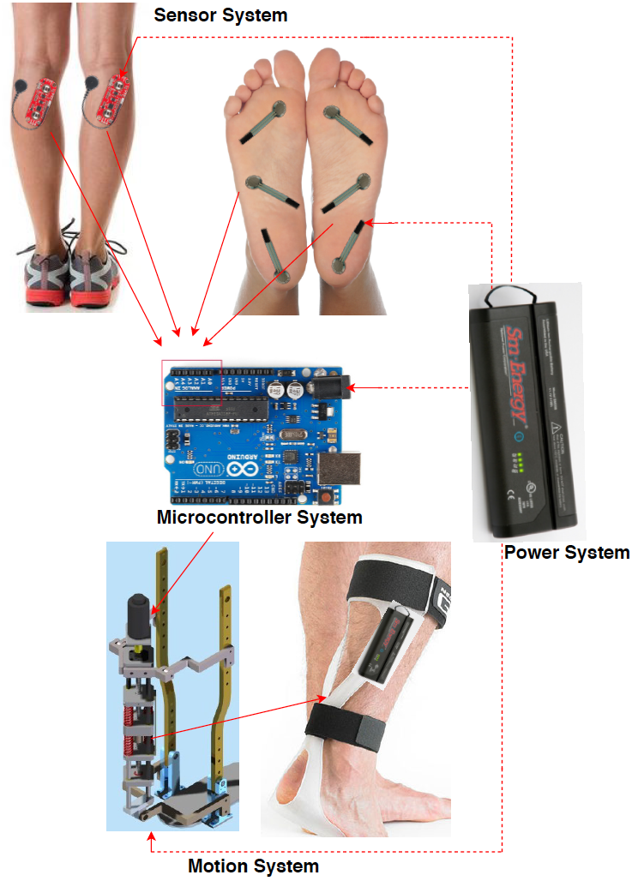
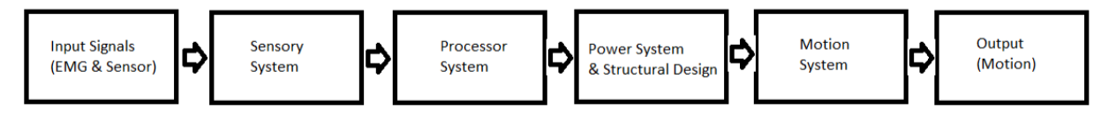
System Overview
EMG sensors and FSR sensors will measure electrical activity and pressure in the leg and foot.
The AAFO will transport signals from the 2 sensors to the MCU.
The microcontroller will interpret signals and determine which stage of gait the user is in and supply corresponding motor control.
The motion system, which acts as an artificial muscle, will move the joint by attaching to a rigid structure.

Slide 3
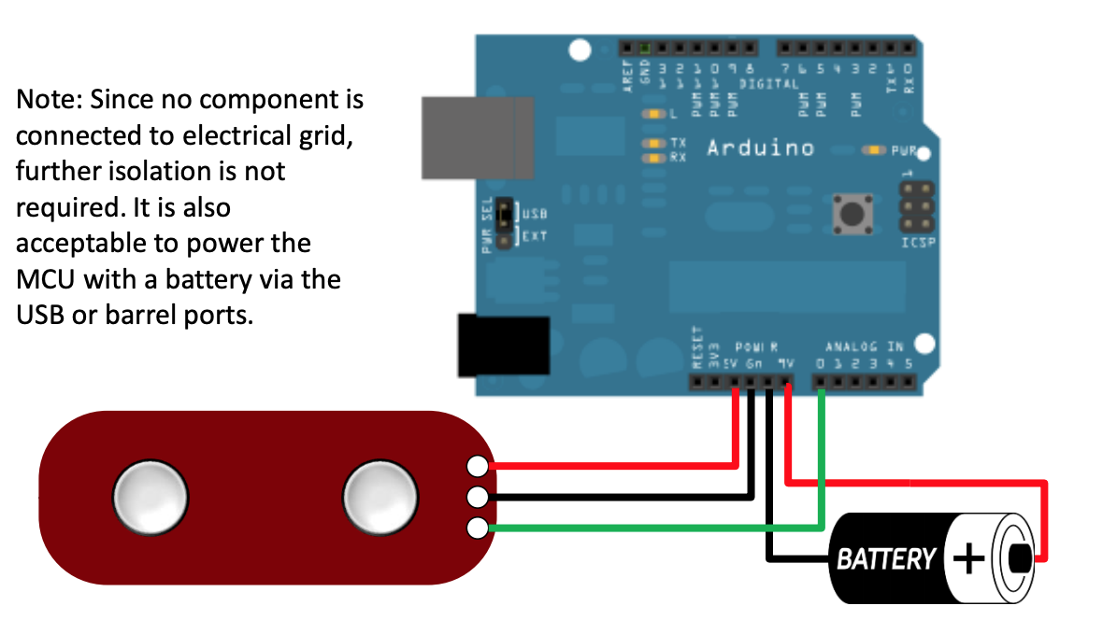
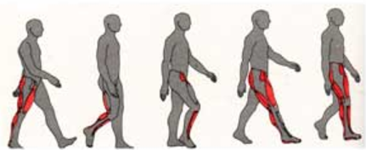
Sensor System - EMG Sensor
Accomplishments
Simulated EMG Sensor System on paper.
Confirmed power requirements match expected.
Finalized muscles to be observed.
Ongoing progress/problems
Artificial Muscle interferes with signals and placement of EMG sensor.
Need for Magnetic Shielding identified.
Awaiting arrival of parts to begin testing.
Identify precise location of sensor on muscle

Slide 4
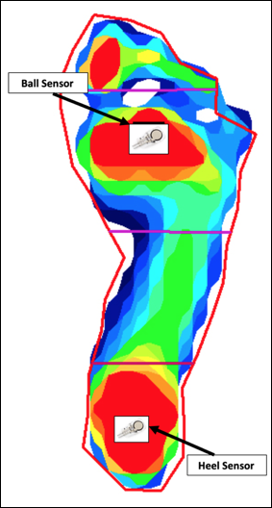
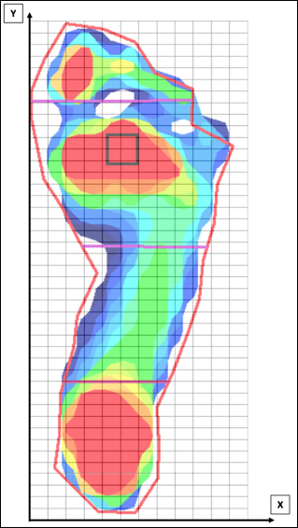
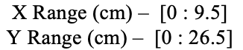
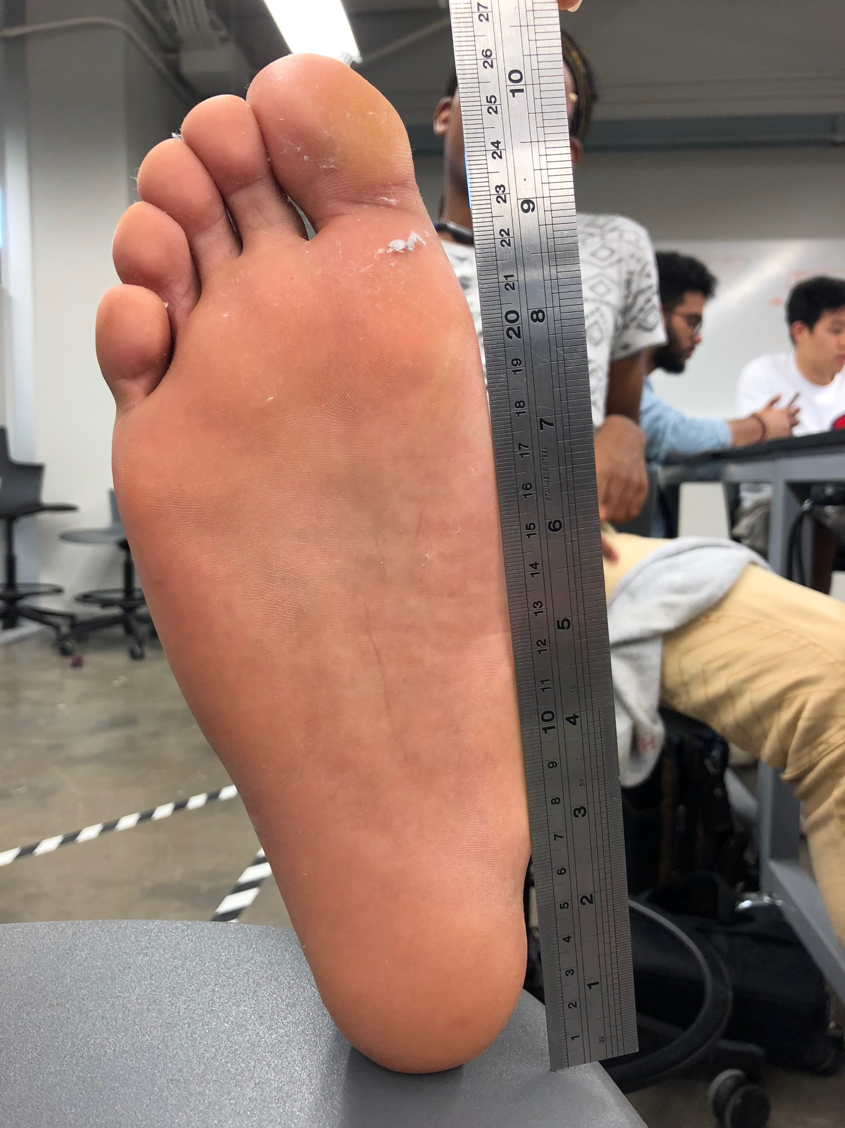
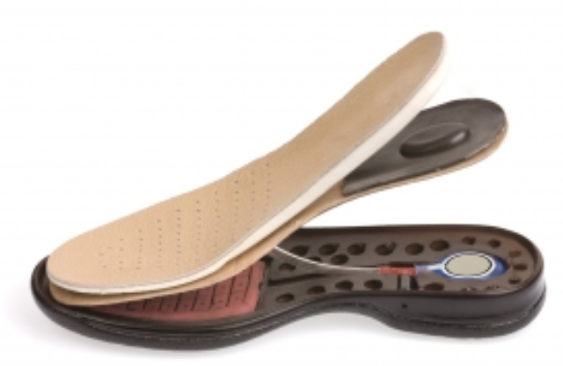
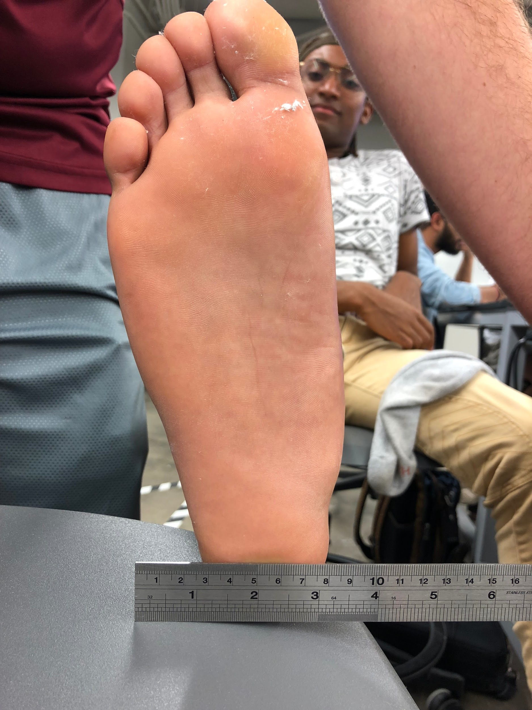
Foot Dimensions and Pressure Sensor Locations
Accomplishments
Identified foot dimensions and pressure sensor locations (in X & Y dimensions and between soft & rigid supports).
Ongoing progress/problems
Exact location in Z is TBD.

Slide 5
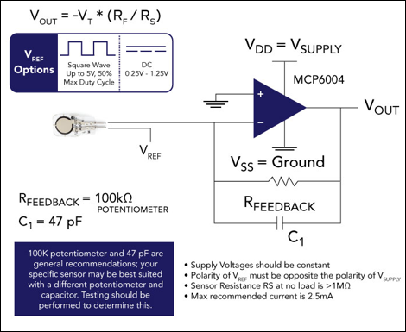
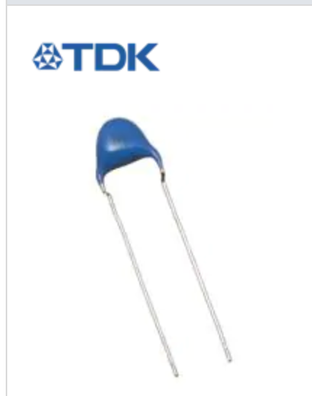
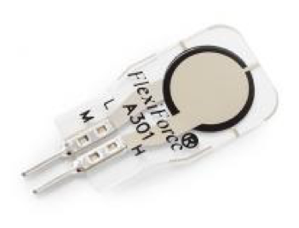
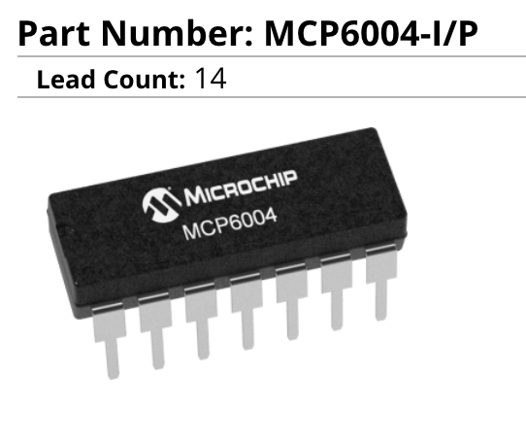
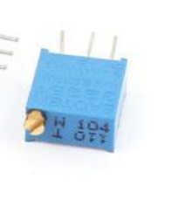
Pressure Sensor System Development
Accomplishments
Pressure Sensor system (including circuit) designed and parts identified.
Simulated circuit on paper.
Confirmed power requirements match expected.
Ongoing progress/problems
Awaiting arrival of parts to begin testing.

Slide 6
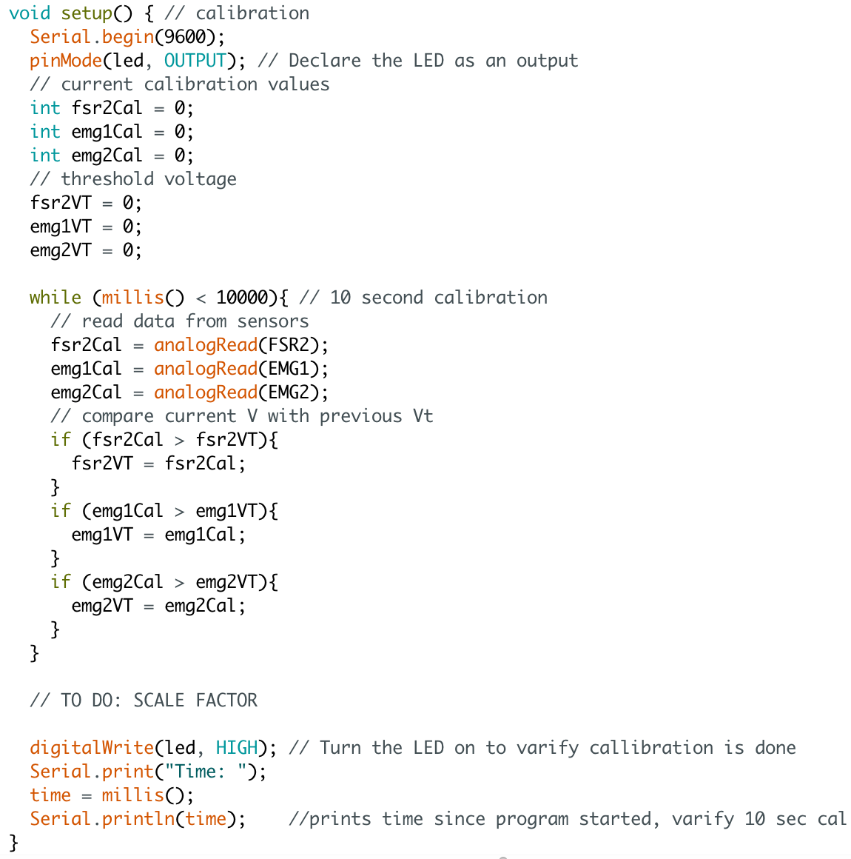
Microcontroller System - Polina
Accomplishments - 12 hours
Began preliminary coding and implemented calibration
Continuously verified and uploaded code to arduino
Ongoing progress/problems and plans
Collect sample data from EMG sensors to use for testing
Modify code to match raw data
Finalize motor output function
Test collected data with finalized code

Slide 7
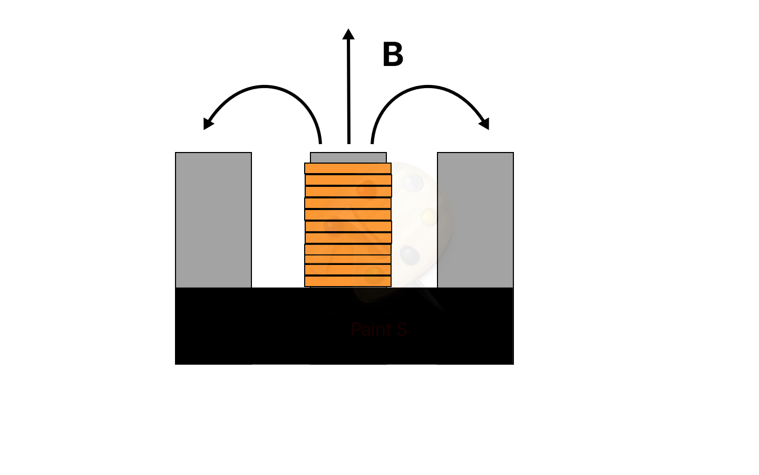
Artificial Muscle/Motion System Development
Accomplishments
Threshold Magnetic field for human body addressed
Design Optimization
Analytical Simulations
Ongoing progress/problems and plans
Part quality could cause further optimization and design problems

Slide 8
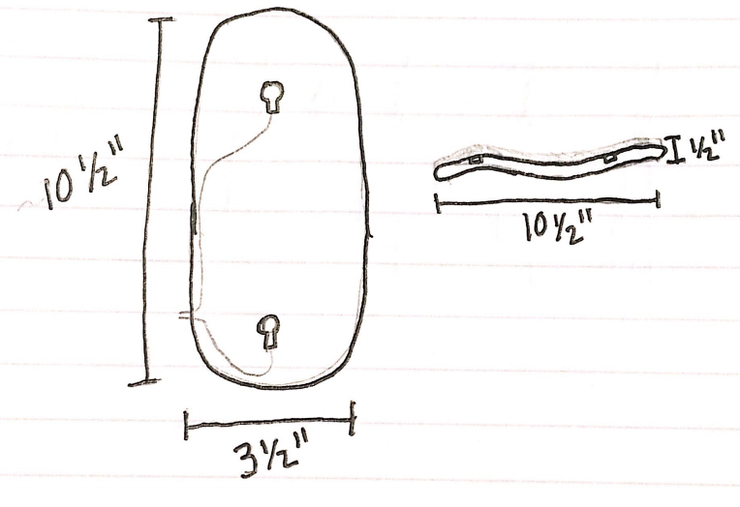
Structural Design
Accomplishments
Subsystem components and component dimensions finalized
Ongoing progress/problems and plans
Artificial Muscle needs to be moved to front of foot
Potential conflict with AM and EMG sensor due to electromagnetic waves
Shielding material may be needed - soft support material
Draft potential solutions in CAD

Slide 9
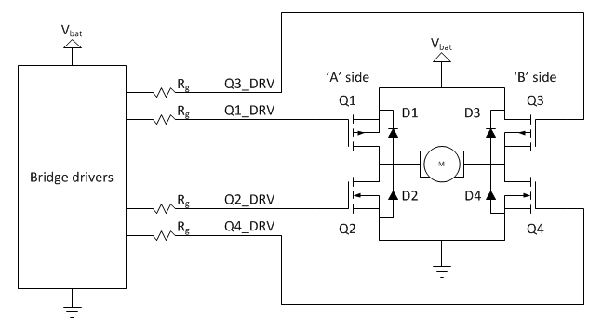
Power System
Accomplishments
Battery acquired - 11.1V LiPo, 4000mAh
Design constraints addressed (Artificial Muscle & Microcontroller)
Ongoing progress/problems and plans
H-bridge to address AM movement requirements & interface AM and MC
Resistor switches for “high speed” and “medium speed” movement
Breadboard testing once AM is built
Notes:
10 pins power req for MC, 0.7A for max current needed for AM, 0.65 minimum, switch solution for speed control

Slide 10
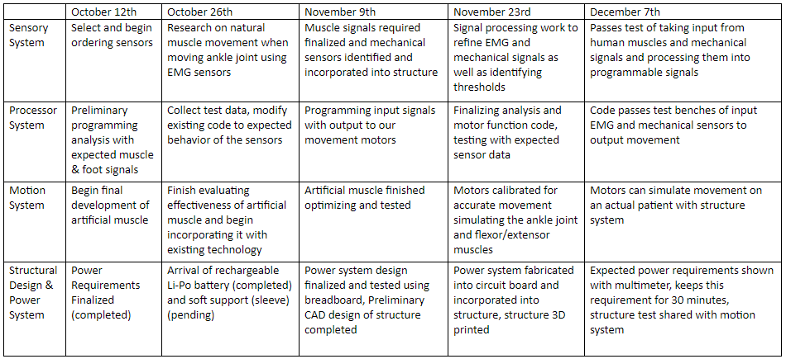
Updated Execution Plan

